Slide 1
Thermal Expansion
When the solid turn to solid but bigger

Slide 2
Review

Slide 3
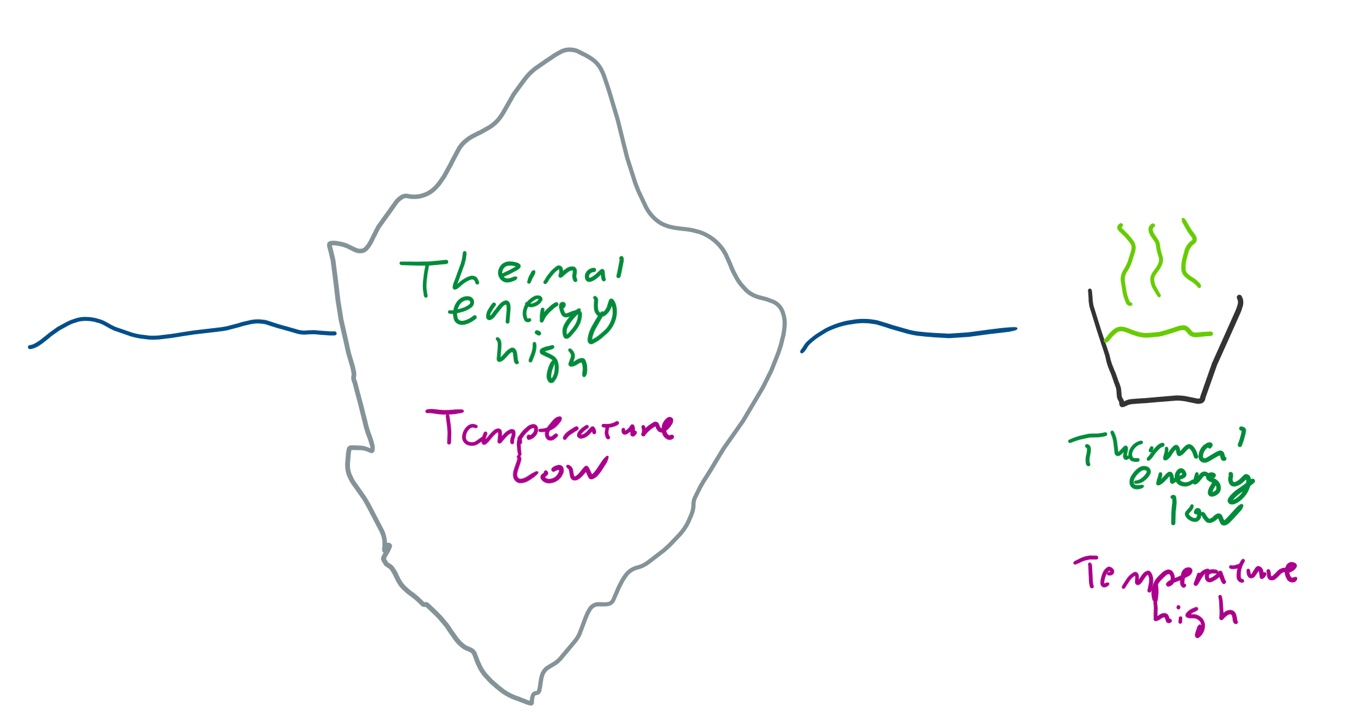
Temperature
The average amount of energy the particles have
Opposed to thermal energy: the total amount of energy a sample has

Slide 4
Solids?

Slide 5
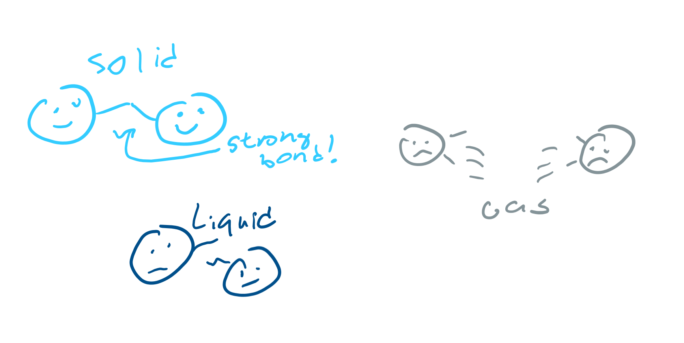
Structure
Strongly connected particles
To weaken bonds, takes energy (like how it takes energy to pull apart two magnets)
When energy given, bonds stretch

Slide 6
Thermal Expansion

Slide 7
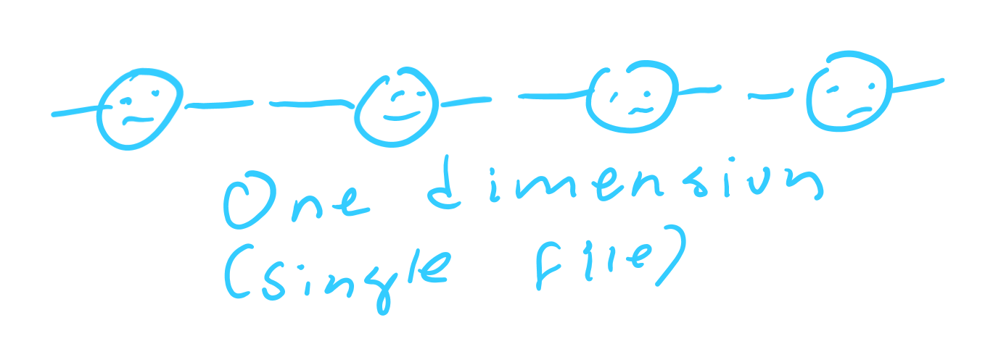
Dimensions?
We will talk about 1D (one dimension) so the particles can only stretch in one direction

Slide 8
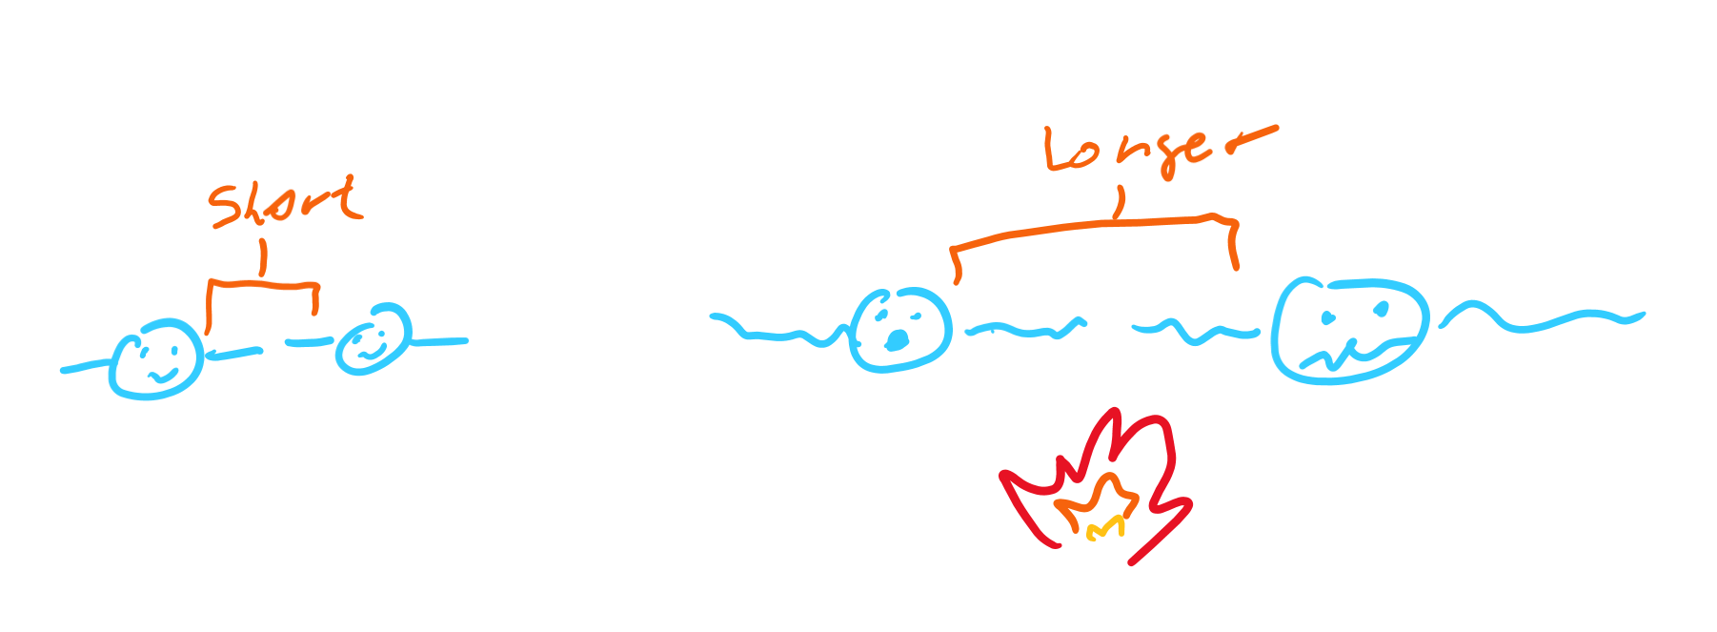
Expansion
Average amount of energy between bonds proportional to stretchy
If temperature higher, distance between particles more

Slide 9
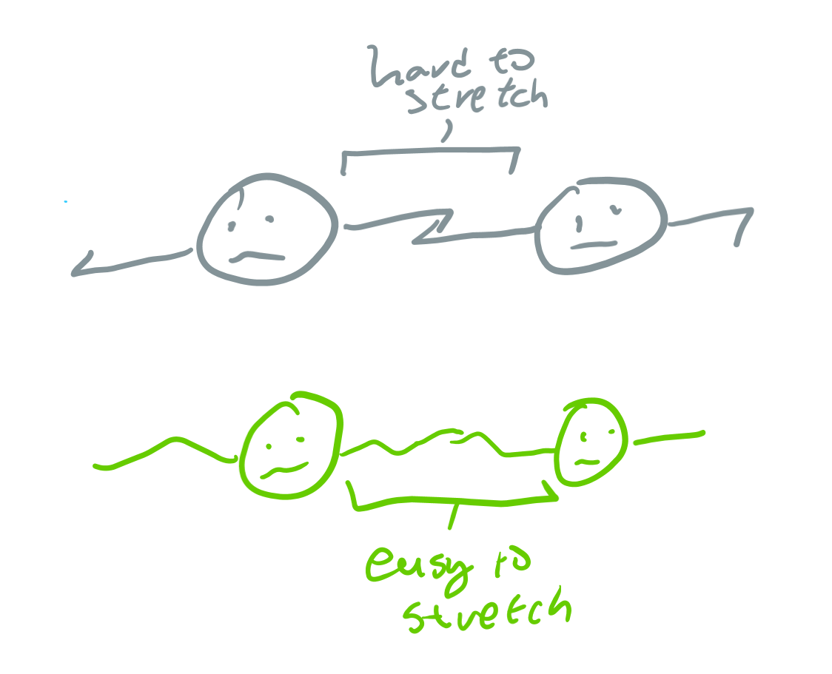
Stretchiness
Some substances stretch (or expand) more when temperature is added
The “stretchiness” of a substance is called the “thermal expansion coefficient”

Slide 10

How to remember?
Symbol: α (alpha)
Is a in Greek
If you stretch someone out they’ll scream aaaaaa
Ez claps

Slide 11
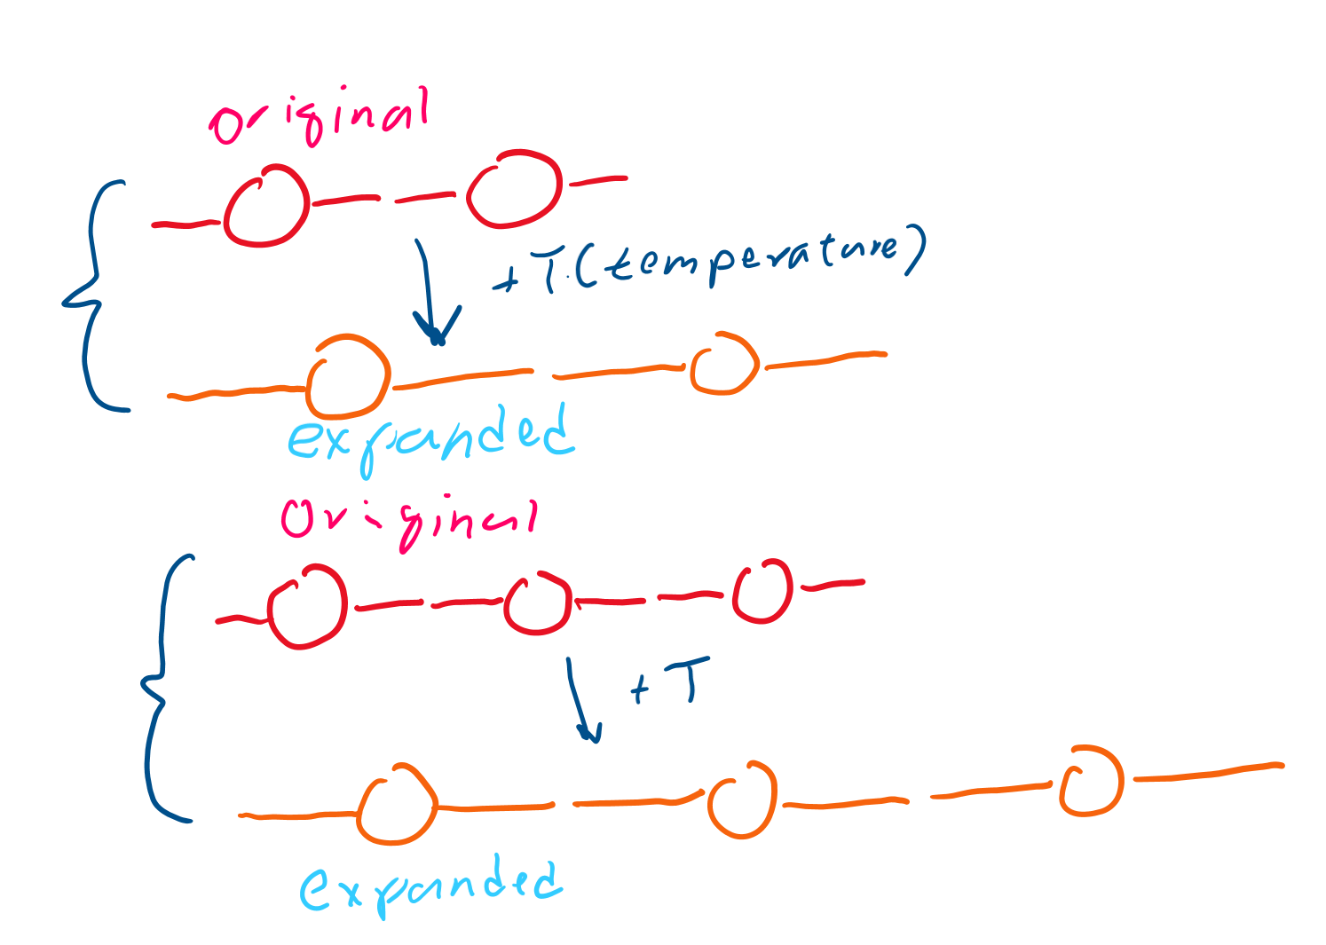
Length and expansion
If the average length of bonds increases, which system on the right sees a longer change in length?

Slide 12
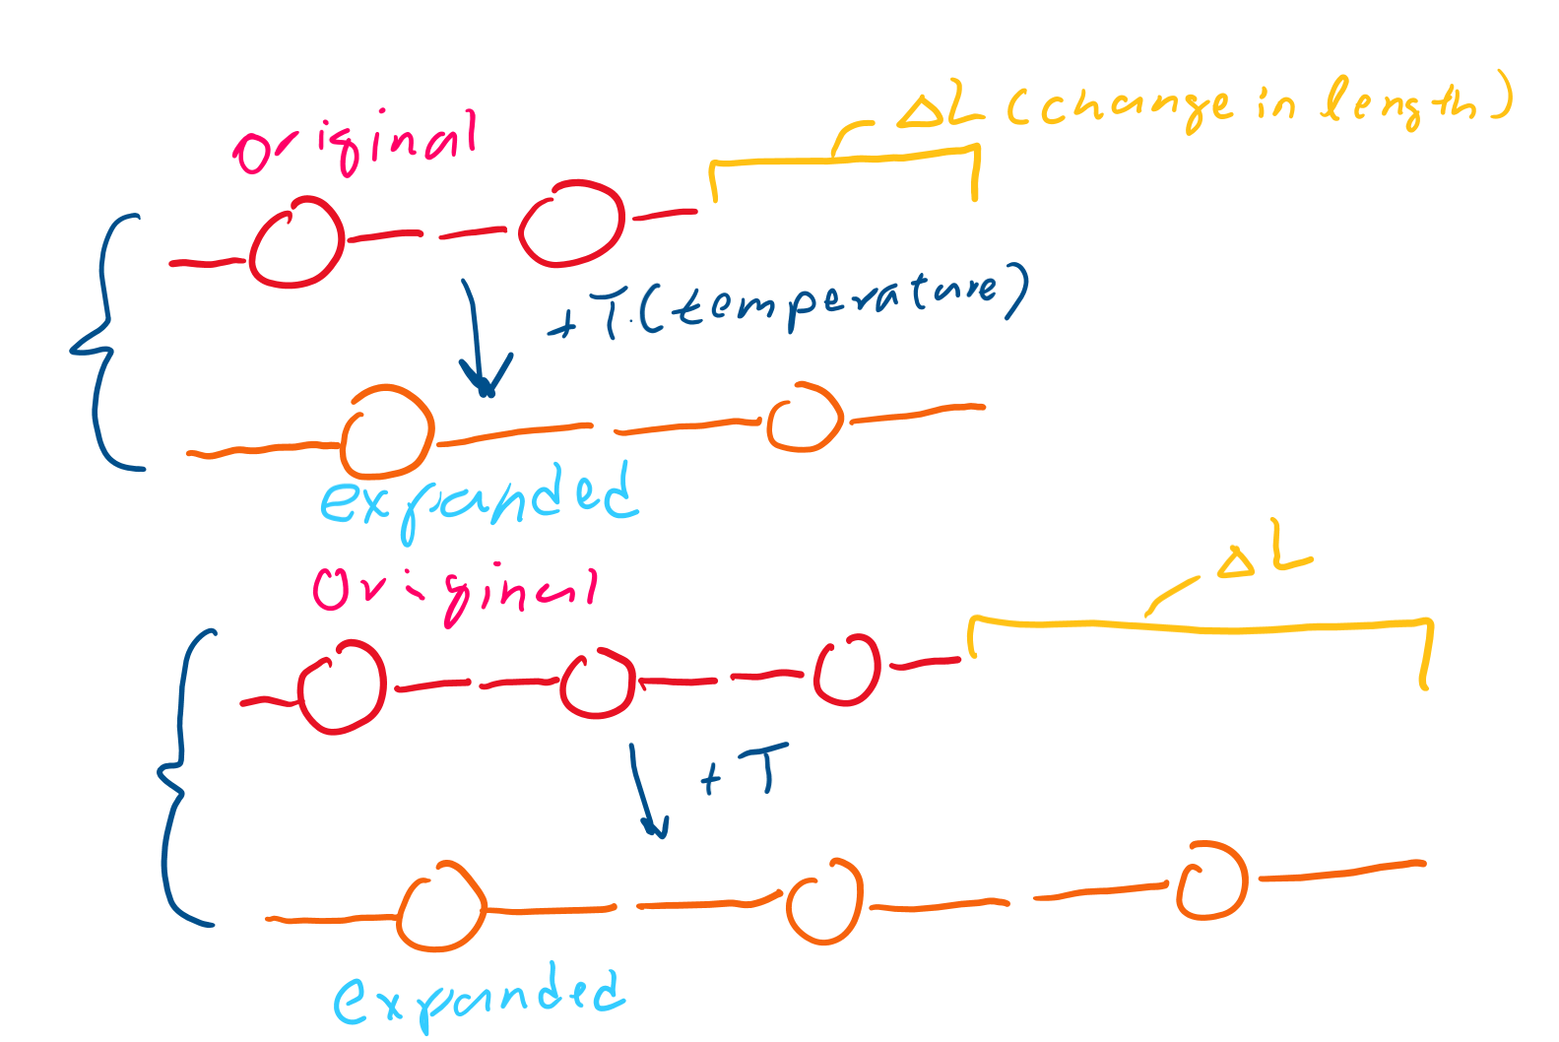
Original length
The bottom one!
It had a longer original length, so it was able to stretch a longer distance!

Slide 13
Equation

Slide 14
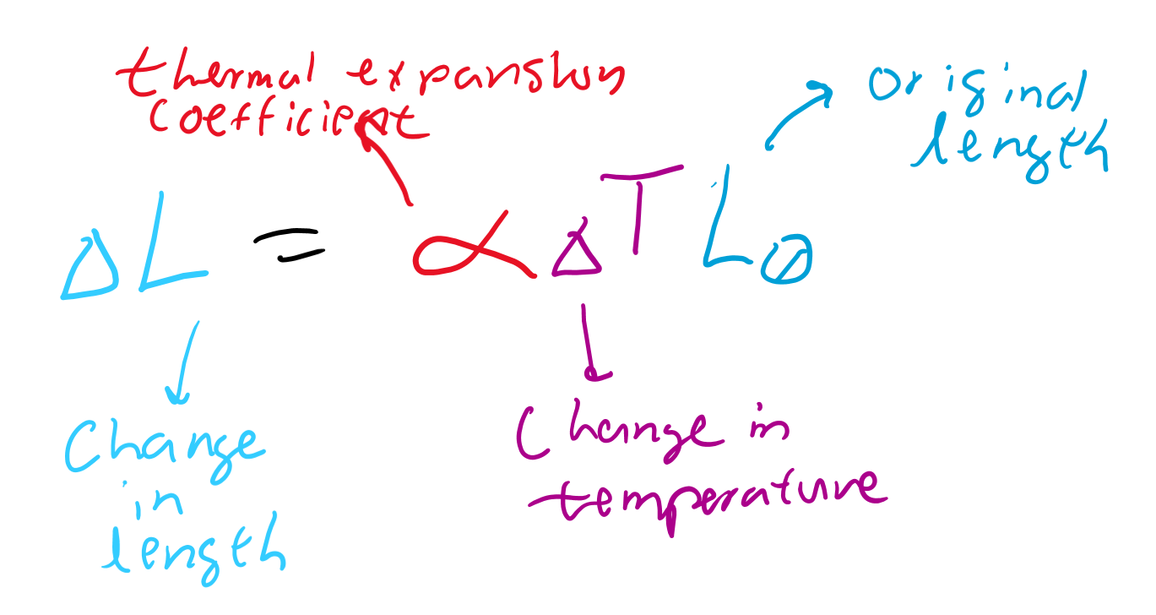
Change in Length
More change in temp means more change in length
More “stretchiness” means more change in length
Longer original length means more change in length

Slide 15
More dimension?

Slide 16
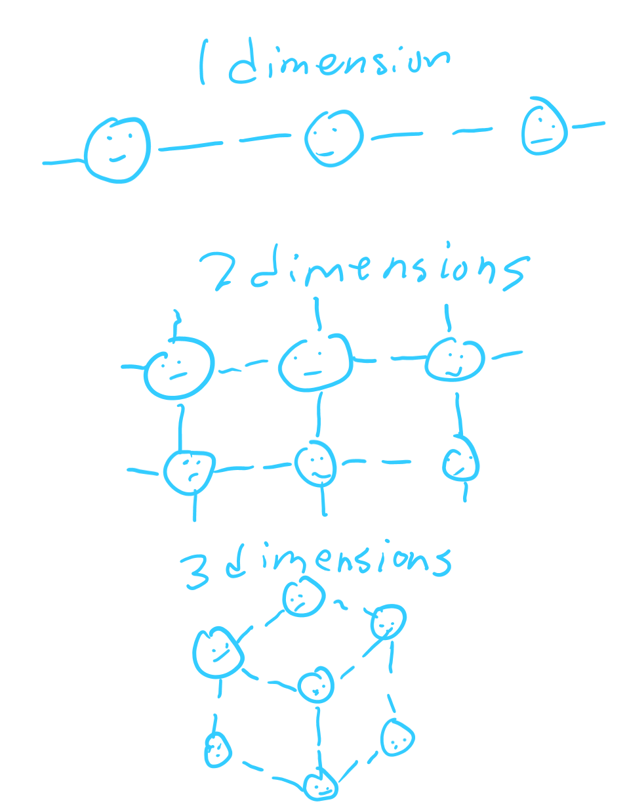
Other dimensions
1D is like a long rod (what we were using before)
2D is like a flat plate
3D is like a cube or any shape that is not flat

Slide 17
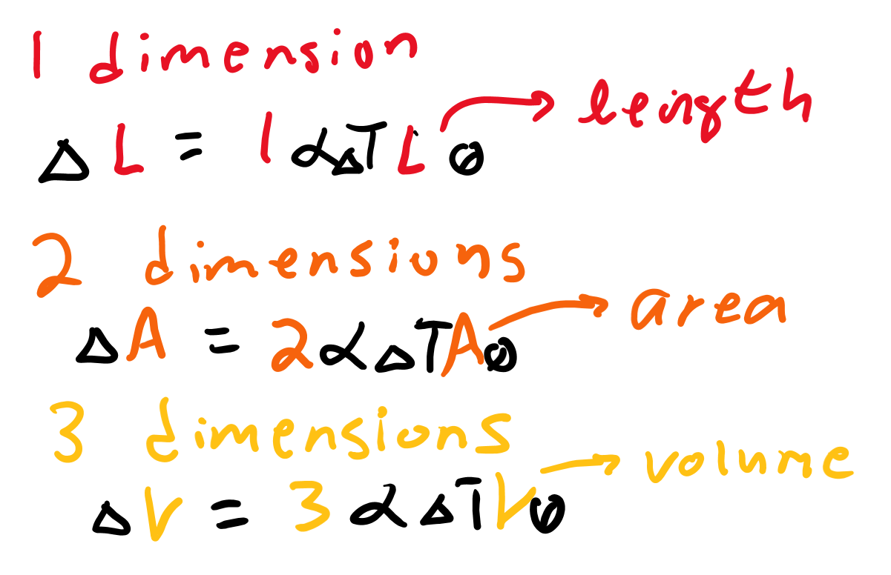
Equations

Slide 18
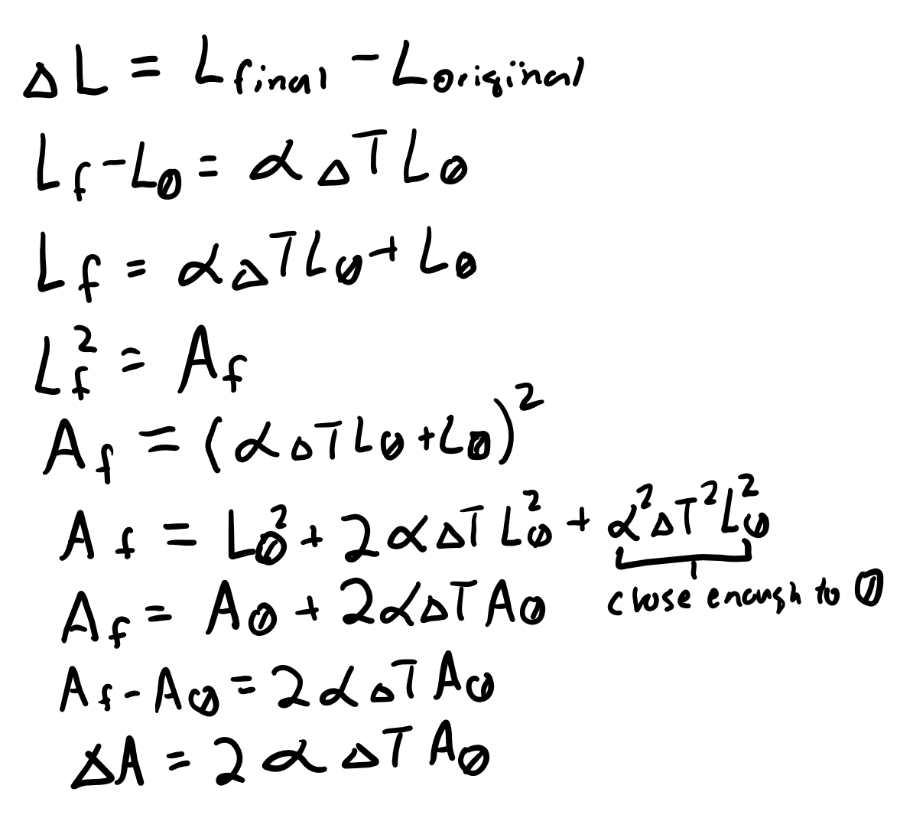
Derivation to 2D (too hard, no need to memorize)

Slide 19
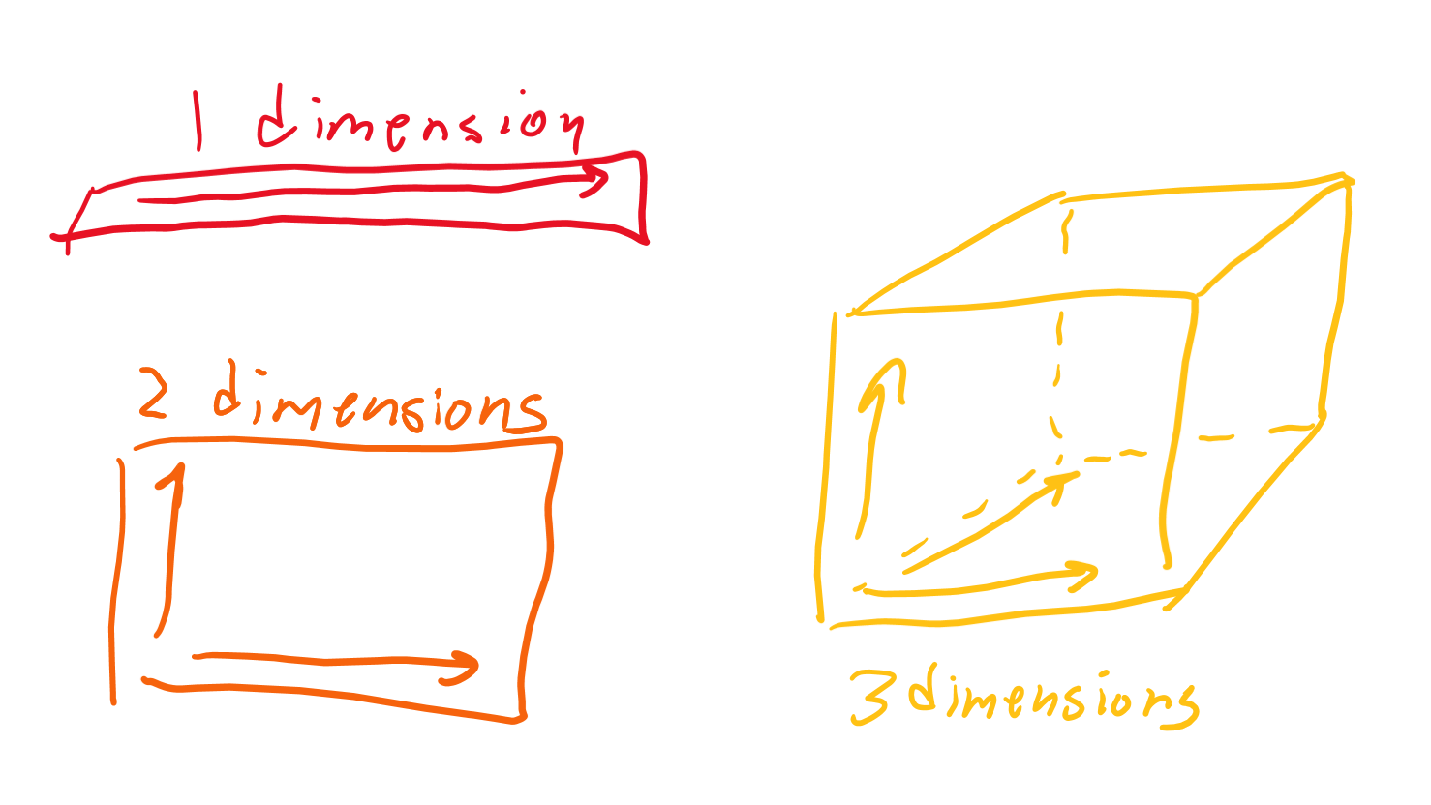
Derivation boring
Here’s the conceptual way to remember it:
In 2D you can stretch in 2 directions
In 3D you can stretch in 3 directions
See? It’s like 1D but in more directions!

